Slide 1
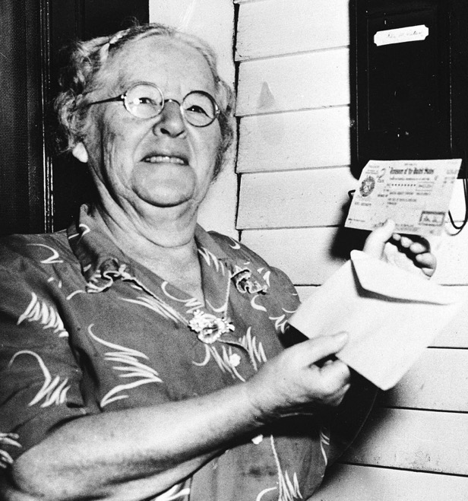
What do they share in common?
Notes:
These two ladies were born 72 years apart but they share something in common.
Does anyone know what that is?

Slide 2
Ida May Fuller
First Social Security
recipient (1944)
Notes:
Ida May Fuller received the very first Social Security check in January of 1944.
Millions would follow her over the next few decades, a golden era of retirement where many stopped working, claimed Social Security, and received a company pension.
Retirement was relatively uncomplicated.

Slide 3
Kathy Casey-Kirschling
First baby boomer eligible for Social Security (2008)
Notes:
Kathy Casey-Kirschling was the first baby boomer, one of 78 million boomers born after the war.
But unlike the seven decades of Social Security claimants before Kathy, boomers face a more challenging retirement.
Many don’t have company pensions.
And as they move into retirement, they must figure out how their lump-sum savings will be turned into a reliable retirement income stream.
That’s what we’re here to discuss.

Slide 4
3 Keys to Income Planning and Answering, “What’s Next?”
Advisor Name
Firm
Location
Disclosures
Notes:
Welcome. My name is Sean Bailey, I’m an advisor with Horsesmouth Financial.
ADVISOR NAME.
THEN DELIVER A SHORT BIO ABOUT YOURSELF. KEEP IT SHORT. THEN CONTINUE
Thanks for being here to listen to our presentation, “3 Keys to Income Planning and Answering, “What’s Next?”.
ADDRESS HOUSEKEEPING TOPICS SUCH AS:
HOW LONG THE PRESENTATION WILL LAST—ABOUT 30 MINUTES
MENTION YOU ALWAYS OFFER A COMPLMENTARY FOLLOW UP MEETING TO ANSWER PEOPLE’S PERSONAL QUESTIONS AND YOU’LL TELL THEM MORE ABOUT THAT LATER
LET THEM KNOW YOU’LL ASK THEM TO COMPLETE EVAULATION FORM ABOUT YOUR PRESENTATION IF YOU’RE DOING ONE. THEN SAY…
Several times a year I deliver presentations like this for my clients and other select individuals.
I finds it’s important to educate people about personal finance and retirement.
As a financial professional, my goal is:
To help people save money.
To help people grow their money.
And to help people make their money last in retirement.
During my career, I’ve found that learning about how to make your money last is one of the most important topics we can discuss.
That’s because…

Slide 5
Challenge Americans spend decades working, saving, and anticipating retirement. But as they approach their post-work life, many don’t know how their retirement savings will generate a reliable source of protected income.
Notes:
Many people face this challenge:
They spend decades working, saving, and anticipating retirement.
But as they approach their post-work life, many are unsure how to make their retirement savings generate a reliable source of protected income that will last a lifetime.

Slide 6
Study: 8 out 10 pre-retirees don’t have a plan they follow
Don’t have any kind of plan
Have a set of goals or a direction in mind but it’s not a well-developed plan
Have a general financial plan, but it doesn’t go far enough
Have a specific financial plan that I follow
Source: Protected Lifetime Income Index Study,
Alliance for Lifetime Income
Notes:
You can see the challenge here in the results of this survey by the Alliance for Lifetime Income:
Only 2 out of 10 people, 20%, have an organized plan that they closely follow. You see that on the right.
The remaining 80% either don’t have a plan (25%), have goals or direction but not a well-developed plan (35%), and another 20% have a plan but say it doesn’t go far enough.
So it’s not surprising, people face a lot of unknowns and unanswered retirement questions…

Slide 7
People face a lot of unknowns and unanswered retirement questions…
Pensions
Longevity
Social Security
Healthcare
Long term care
Paycheck
Notes:
Let’s talk for a moment about each of these retirement unknowns.
Your specific situation in each area will play a role in developing an income plan for retirement.
Pensions: If you don’t have one, or expect to also rely on an IRA or a 401(k), you might wonder, “How long will my money last?”
These days fewer people have traditional pensions from their employer with secure income options.
Longevity: How long will my retirement last?
20-30-year retirements are not uncommon, yet people typically underestimate how long they’ll live. Just to turn back to our slide of Ida Mae Fuller, the first Social Security recipient. You may be surprised to hear she lived vastly beyond her average life expectancy. She collected Social Security until her death at age 100-- a 35-year retirement.
Social Security: How much of my retirement income will come from my SS benefit?
On average, the SS benefit accounts for about 40% of retirement income. That means your income plan will want to address other sources of income, as you’ll see later.
Healthcare: How much will it cost me in retirement?
Medicare insurance costs take a big chunk of people’s cash flow. Some of it you paid for with your payroll tax contributions but it’s not totally free.
Long term care: How will I pay for my care during my final years?
BTW, one unknown about LongTerm Care: Medicare DOES NOT cover long term care—many people think it does and are shocked to learn that’s not true.
Paycheck: When I stop working and income stops, how will I cover my essential expenses?
Your checking account is no longer getting replenished in the same way. Yet we keep on spending, even when we’re not working.

Slide 8
A possible solution? Income planning…
Notes:
For anyone thinking about their retirement future, those are daunting observations.
But as you’ll see, when people start thinking about “income planning,” many of these issues get addressed.
And as you create solutions, your confidence and outlook about what you can achieve in retirement gets a boost, too.
So, after looking at our challenge here, you may be thinking…

Slide 9
“What’s the first key thing to understand when considering how your savings becomes a reliable source of income?”
?
Notes:
What’s the first key thing to understand when considering how your savings becomes a reliable source of income?
That brings us to our first key…

Slide 10
Key #1 Income planning is a critical subset of retirement planning because it focuses on the income you’ll need in order to live the life you want.
Notes:
Income planning is a critical subset of retirement planning because it focuses on the income you’ll need in order to live the life you want.

Slide 11
WHY IS INCOME PLANNING SO IMPORTANT?
Answers how essential expenses are covered in retirement, especially essential costs
Considers funding of needs, wants, and wishes
Matches income sources to projected budget
Addresses risk of income shortfall
Notes:
So you may be wondering, why is income planning SO important?
There are a number reasons.
It answers how your expenses are going to be covered in retirement.
That means understanding that you actually have different kinds of expenses:
Those that deal with Covering Your BASIC NEEDS are different from those related to your WANTS, and your WISHES.
Income planning involves matching your sources of income with your projected budget.
It also addresses the risk of a potential income shortfall, that is, not having enough money to cover your expenses.
Now, you may be thinking…

Slide 12
HOW DOES INCOME PLANNING DIFFER FROM RETIREMENT PLANNING?
Retirement planning:
During working years, focuses on saving and investing with an eye toward the future.
Income planning:
During retirement, focuses on spending, cash flow, and managing investments.
Notes:
How is income planning different from retirement planning?
Retirement planning focuses on saving and investing during your working years with an eye toward the future.
Income planning focuses on spending, cash flow, and managing investments during your retirement.
So let’s look at the key risks income planning addresses…

Slide 13
An income plan helps you address…
Longevity
Inflation
Cash flow
Market volatility
Notes:
An income plan helps you address some of these important issues:
Longevity risk: How long you are hoping to live and what are the things you want to do while you still can?
Inflation risk: How will you maintain your lifestyle as as the costs of life’s basics increase over time?
Cash flow: How do you ensure that your savings can generate enough reliable income to meet your goals.
Market risk: The value of your investment portfolio can swing wildly—how much of your savings will be exposed to market volatility?.

Slide 14
“Okay, I see the importance of income planning, so what’s the next most important thing to address?”
?
Notes:
Now, you might be saying, “Okay, I see the key role of income planning so what’s the next most important thing to address?”
And here it is, our second key.

Slide 15
Key #2 It’s important to understand the difference between the two main schools of thought for retirement income planning.
Notes:
It’s important to understand the difference between the two main schools of thought for retirement income planning.
Let’s see exactly what that means…

Slide 16
Two main schools of thought with retirement income planning
Systematic withdrawal approach
Safety first approach
Notes:
You might not realize that there ARE two schools of thinking when it comes to retirement income planning.
One school of thought is known as the systematic withdrawal approach.
The other school we refer to as the safety-first approach.

Slide 17
Each approach uses retirement savings differently
Systematic withdrawals approach generates probable income
Safety first approach adds in protected lifetime income
Notes:
As we will see, each school uses retirement savings differently.
The systematic withdrawals approach generates something called probable income. That would be income that can vary.
That’s because the rate of withdrawal has changed over the years—it’s been higher, it’s been lower. It changes and will likely continue to change.
The safety-first approach adds protected lifetime income into the mix, as we’ll see in a minute.
But let’s learn more about the systematic-withdrawals approach first.

Slide 18
Systematic withdrawal income planning answers:
How much can retirees confidently withdraw from their retirement savings without running out of money?
Notes:
The key question the systematic-withdrawals approach answers is this:
How much can retirees confidently withdrawal from their investments without running out of money?
In some years you could take out more income, while in other years you might be forced to take out less.
It depends on how much you have and how well it’s been doing.
Either way it’s up to you to make that decision.

Slide 19
Chief goal of systematic withdrawals
Maximizing income to support retirement lifestyle for 30 plus years.
Notes:
The chief goal of the systematic-withdrawals approach is to maximize SPENDING to support a retirement lifestyle that could last 25-30 years or more.
The emphasis is on monitoring your spending.

Slide 20
HOW DO SYSTEMATIC WITHDRAWALS AND PROBABLE INCOME WORK?
Select an annual rate of withdrawal (Ex: 3%, 4%, 5%)
Probability of long-term success is not guaranteed
Rarely uses annuities for protected income
Notes:
So how do systematic withdrawals work?
First, as a rule of thumb, this approach involves systematic withdrawals from your retirement savings assets.
The probability of long-term success is not guaranteed. That’s what makes it “probable income,” which is income that can vary.
You’ve got to be comfortable with the risk associated with your chosen withdrawal rate.
If you had a 90% chance of being successful, that might be good for you
But, what if the success/failure rate is 80/20 or 70/30…Could you live with that?
Everyone has to make that determination for themselves.
What are you going to do if the probability turns against you?
And a key aspect of this approach is that it doesn’t consider using annuities to generate lifetime income.

Slide 21
Examples of systematic withdrawal probable income:
Systematic stock portfolio withdrawals
Bonds
Capital gains
Dividends
IRA/401k/403b distributions
Interest
Rental income
Notes:
Here are common examples of probable income sources:
Systematic withdrawals from a diversified stock portfolio
Bonds
Capital gains
Dividends
IRA/401K/403B (required minimum distributions)
Interest
Rental income

Slide 22
Chief drawbacks of a systematic withdrawal approach
Exposure to market risk
Generates less money in down markets
Hard to recover when starting retirement in a recession
Doesn’t protect against longevity risk –you could run out of money
Notes:
Let’s look at the drawbacks of the systematic approach
Naturally, it has exposure to market risk
Of course, that market risk is the one method it uses to help maximize total spending.
But when the markets are down, the systematic withdrawal approach might generate less income and the timing and duration of a down market must be considered.
If you’re unlucky and experience a prolonged down market or a recession early in retirement, it’s much harder to recover.
And there’s the longevity risk: It doesn’t protect you in the event that you live longer than you planned
Okay, so now let’s look at the safety-first approach of income planning…

Slide 23
Safety first income planning answers:
How do you live a full life and get the most satisfaction, once you’ve funded your essential expenses?
Notes:
The safety-first approach answers this question:
How do you live a full life and get the most satisfaction, once you’ve funded your essential expenses?

Slide 24
Chief goal of safety first
Fund your basic, or essential, expenses first with protected lifetime income, followed by wants and wishes spending.
Notes:
The chief goal of the safety-first approach is to first safely fund your basic, or essential, expenses with protected lifetime income.
Then, once those “non-negotiable expenses” are safely covered, you’re in a position to pursue funding your wants and wishes.

Slide 25
HOW DOES SAFETY FIRST AND PROTECTED INCOME WORK?
Generates a portion of retirement savings you can’t outlive
Builds a “floor” of safe, or guaranteed, income to meet essential spending needs
Includes Social Security and pensions
Features annuities as a key role in creating protected lifetime income
Notes:
So let’s look at how safety first and protected income works…
A key aspect of this approach is using a portion of your retirement savings to generate a protected lifetime income stream.
That means building a “floor” of guaranteed income to meet your essential spending needs.
That includes Social Security and pensions.
And the safety-first approach often includes using an annuity to create additional protected income.

Slide 26
Examples of safety first protected lifetime income sources:
Only three sources of protected lifetime income
Pension
Social Security
Annuities
Notes:
As we’ve seen, there are only really three sources of protected income:
Pensions
Social Security
Annuities

Slide 27
Chief drawbacks of safety first approach
Limited options: Social Security & pensions not enough
Solutions can be intricate and tie up a portion of retirement savings
Securing protected income may have a broader range of costs
Safety of no market risk also means no market returns
Notes:
Now let’s look at the drawbacks of the safety-first approach
Limited options: Social Security & pensions are not enough.
Solutions such as annuities can be intricate and tie up a portion of your retirement savings.
Securing protected income may have a broader range of costs.
The safety of no market risk for a portion of your portfolio also means no market returns for that portion.

Slide 28
ESSENTIAL DIFFERENCES BETWEEN THE TWO APPROACHES
Systematic withdrawal:
Accepts the risk of markets and funds retirement income through systematic withdrawals hoping to last for 30 years
Safety first:
Removes risk of running out of money in retirement by using protected lifetime income to fund basic spending
Notes:
So you may be asking, what are the essential differences of the two? This is how we see it:
The systematic withdrawal approach accepts the risk of the markets.
Your income is derived from systematic withdrawals which you HOPE lasts for 30+ years.
Now, for the safety-first approach, there is certainty with protected lifetime income.
It removes a portion of the risk of running out of money in retirement by using protected income to fund your basic expenses.
And this brings us to a key income planning observation…

Slide 29
Two roads to consider: Which do you take?
The road of systematic withdrawals
The road of safety first
Or a combination of both?
Notes:
There are two roads to consider. Which do you take?
There’s a systematic approach along with the probable income it generates.
And there’s a safety-first approach that includes protected lifetime income.
Or is it possible to use both?

Slide 30
A DIVERSIFIED PORTFOLIO INCLUDES PROTECTED AND PROBABLE INCOME
Probable income to benefit from market growth
Protected income to cover essential expenses, and even more
Notes:
A diversified portfolio includes both protected income and probable income.
One portion benefits from probable income derived from market growth.
The other protected portion covers your essential expenses, and sometimes more.
Naturally, this raises a question you may have on your mind…

Slide 31
“How do I know how much protected income I will need?”
?
Notes:
“How do I know how much protected income I will need?”
It’s a very good question.
And that brings us to our next key…

Slide 32
Key #3 Using an “Income Hierarchy Analysis” helps you understand how your income will be applied to covering your needs, wants, and wishes in retirement.
Notes:
Developing an “Income Hierarchy Analysis” helps you understand how your income will cover your needs, wants, and wishes in retirement.
You’re probably wondering what is an Income Hierarchy?
So let’s take a look at something you may have seen before…

Slide 33
Maslow’s Hierarchy of Needs
Need for self-actualization
Always need to address the bottom before moving up to the next step.
Need for self-esteem
Social needs/belonging
Need for safety/security
Physical survival needs
Notes:
This is Maslow’s Hierarchy of Needs.
Maslow was a psychologist whose theory of motivation tells us that we have five categories of needs.
We only pursue our higher needs once we’ve satisfied our more basic needs lower down the pyramid.
So we always need to fill our needs at the bottom before moving up to the next step.

Slide 34
An income hierarchy includes needs, wants, and wishes
Needs: Essential expenses
Wants: Lifestyle expense
Wishes: Trips, legacy, once in a lifetime events
Notes:
Maslow’s hierarchy can inform our thinking around retirement income planning.
An income hierarchy includes needs, wants, and wishes
We start out with funding our essential basic expenses—that covers our needs, at the bottom.
Next, we move up to our wants. That covers lifestyle expenses...the fun stuff.
This could be a range of things and varies from family to family.
And then we get to wishes and how we fund such things such as a once-in-a- lifetime trip, or making a legacy bequest to a church or beloved organization.
Funding wishes may not be for everyone, of course.

Slide 35
Calculating your expenses
Add up essential monthly expenses
Create income plan that covers your basics
Focus on pursuing your passions
Goal: Feel secure knowing that your basics are covered
Notes:
So let’s take a look at what does impact everyone—covering your basic, essential expenses.
It’s not a mystery, but it’s something people haven’t necessarily figured out.
Yet it’s critical to know how you are going to cover those essential monthly expenses.
In a minute, we’ll look at a list of more than 60 examples of common retirement expenses.
Our goal here at the bottom of the income hierarchy is to get those essential expenses covered.
Then you’ll be able to focus on pursuing your passions in retirement and living a full life.
That’s the goal. Knowing you feel secure.

Slide 36
Is there an income security gap?
How much income needed?
How to fill the gap?
Notes:
One outcome of working on the income hierarchy is identifying whether you have a security gap.
Simply put, you look at how much monthly income is needed to cover your essential expenses.
Then you look at your income sources.
Do your sources of income in retirement cover your essential expenses?
If yes, great.
If no, then what are you going to do to fill the gap?

Slide 37
Comfort creep and funding your wants
Protected lifetime income covers “wants,” too
Comfort creep: not really “needs” but still important
Examples: lake property, boats, golf club, collector cars, etc.
Notes:
One thing that comes up when people go through the income hierarchy process is something we call “comfort creep.”
People may want their income plan to use guaranteed income to cover some of their wants as well.
For instance, there may be things in your life that you feel you don’t want to live without, even though it’s not what others might consider an “essential expense.”
But to you it is and that’s what matters.
And that’s something we call “comfort creep”: not really “needs” but still important.
You probably get the idea, right?
It’s special things like having a lake property, or a boat, or club membership, or snowbird getaway location, or collector cars, etc.
Let’s look at a case in point…

Slide 38
38
Cover your needs, example:
A married couple in Texas
CASE STUDY: MARRIED WORKING COUPLE
Lives in Texas
65 years old
$600,000 in assets
Ready to retire
Mortgage: $12,000 ($1,000/mo)
Utilities and Home Maintenance Cost: $13,800 ($1,150/mo)
Average Annual Groceries Cost: $5,604 ($467/mo)
Average Health Insurance Cost: $6,096 ($508/mo)
Average Transportation Spending $5,400 ($450/mo)
Owners of Two Horses: $7,752 ($646/mo)
TOTAL BASICS: $50,652 ($4,221/mo)
Joint Social Security: $40,800 ($3,400/mo)
BASICS SHORTFALL: $9,852 ($821/mo)
Expenses Based on Texas Averages and Assumptions
Notes:
Here’s a couple living in Texas. They've got $600,000 in savings and investments that they're going to be relying on.
If we look at the monthly expenses that they consider essential, we have:
A mortgage – $1,200 a month
Utilities and home maintenance – $1,150 a month
Groceries – $467 a month
Health insurance – $500 a month
Transportation – $450 a month
But they also have a hobby. They have a couple of horses they take camping and trail riding with a cost of about $650 a month.
So covering what they consider to be their basic expenses comes to approximately $4,221 a month.
Let’s say Social Security will provide them a total of about $3,400 a month.
So, their security gap is about $821 a month.
That $821 gap is where a financial professional needs to help them secure protected lifetime income to make sure that their basics are covered.

Slide 39
39
Cover your needs, example:
A married couple in Texas
CASE STUDY: MARRIED WORKING COUPLE
Lives in Texas
65 years old
$600,000 in assets
Ready to retire
Mortgage: $12,000 ($1,000/mo)
Utilities and Home Maintenance Cost: $13,800 ($1,150/mo)
Average Annual Groceries Cost: $5,604 ($467/mo)
Average Health Insurance Cost: $6,096 ($508/mo)
Average Transportation Spending $5,400 ($450/mo)
Owners of Two Horses: $7,752 ($646/mo)
TOTAL BASICS: $50,652 ($4,221/mo)
Joint Social Security: $40,800 ($3,400/mo)
BASICS SHORTFALL: $9,852 ($821/mo)
Two Horses
Groceries
Transportation
Utilities & Maintenance
Expenses Based on Texas Averages and Assumptions
Mortgage
Health Insurance
Notes:
Here’s a simple example of what their income hierarchy would look like.
Their plan is to use protected income to cover their basic needs, plus other expenses that they consider essential.
So you see here in the bottom rung, their NEEDS include groceries, transportation, utilities, maintenance, a mortgage and health insurance.
Then, up one rung to their WANTS, you see they’ve listed two horses.
Now this is just one family’s income hierarchy analysis
Of course, yours will be different.

Slide 40
“Okay, I get it. I see the importance of the income hierarchy and income planning. What’s next?”
?
Notes:
So now you might be thinking, “Okay, I get it. I see the importance of the income hierarchy and income planning. What’s next?”

Slide 41
Common income planning questions
How do I really know I’ve anticipated everything?
What steps are needed to creating steady income?
How do we know that we’ll actually have enough?
Notes:
And what’s next is for you to start thinking about your own income plan.
This often raises questions in people’s minds.
Here are some ones we hear often:
What’s the process for identifying sources of income?
How do I really know I’ve anticipated everything?
What steps are needed to create steady income?
How do we know that we’ll actually have enough?

Slide 42
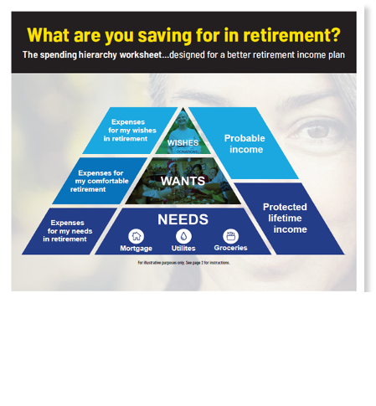
Next steps: Create your own personal income hierarchy
Identify needs, wants and wishes
Understand the costs
Identify income sources
Calculate income security gap
Develop a full income plan
Notes:
And here’s our answer to that next steps question: Start now by creating your own personal income hierarchy.
It’s a very easy process and it gets you thinking about the key elements you want covered in your income plan.
These are the key topics you’ll address:
You start by Identifying your different expenses as we’ve discussed: your needs, wants and wishes.
Then you want to Understand the costs involved AND identify your income sources.
This puts you in position to Identify any income security gap that might exist and that you’ll want to address.
And when you do these things—it doesn’t really take long, at all—you can develop a full income plan for your retirement years.
And we’ve got a simple handout to help you do this…
There was a a link to your copy of this tool in your email reminders about this webinar.
There’s also a link to it in the chat box. Just download and print it out later.

Slide 43
3 steps to a better income plan
How will you spend your money?
How will you prioritize your expenses?
How will you fund them?
Notes:
We start the income hierarchy analysis with this simple exercise: 3 Steps to a Better Income Plan
It assists you in answering these key questions:
How will you spend your money?
How will you prioritize your expenses?
How will you fund them?

Slide 44
Key income planning steps: select, sort, sync
Determine anticipated expenses
Sort into needs, wants, and wishes
Sync income sources with spending hierarchy
Notes:
And these are the key action steps you take as you develop your income plan: Select, Sort, Sync.
You select your anticipated expenses.
Then you sort them into needs, wants, and wishes.
And then sync, or match, your income sources with your spending hierarchy.

Slide 45
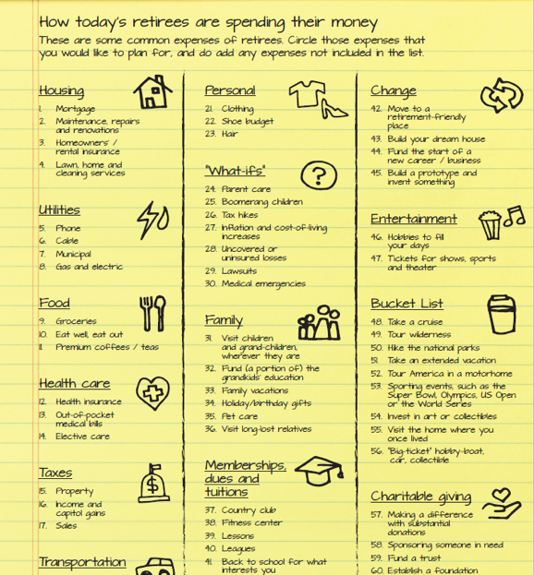
62 common expenses retirees face
Identify the ones you expect and add others not listed
Notes:
Now you may be wondering, “How can I think through all my likely basic expenses?”
It’s a good question and especially because no one person’s income plan will be the same as any other persons.
But you want to try to get down your most common expenses, so your plan is relatively complete.
To help you jog your memory, we’ve created a list that includes 62 Common Expenses Retirees Face
You can go through the list to Identify the ones you expect AND add others that may not be on the list.

Slide 46
Complete your spending hierarchy
Non-negotiable basic needs on pyramid bottom
Comfort wants in middle tier
Wish or dream spending goes to the top
Notes:
And here’s how you will complete your spending hierarchy:
Your non-negotiable basic NEEDS go on pyramid bottom
Your comfort WANTS go in middle tier
And then you add your big WISHES, or dream spending, at the very top

Slide 47
Let’s have an income planning discussion
Notes:
So we’re almost to the end now.
We’ve covered three keys to income planning:
The first key was understanding that income planning is a critical subset of retirement planning because it focuses on the INCOME you’ll need in order to live the life you want.
Our second key was understanding the two main schools of thought about retirement income planning
And we saw how a combination of the two will give you a diversified retirement portfolio of both protected AND probable income.
And we just finished going over the third key about using an income hierarchy analysis to understand how your income will be applied to covering your needs, wants, and wishes in retirement.
Now I’d like to invite you to have an income planning discussion
As I mentioned at the beginning, I always offer attendees of my presentations the chance to have a complementary follow-up meeting or call.

Slide 48
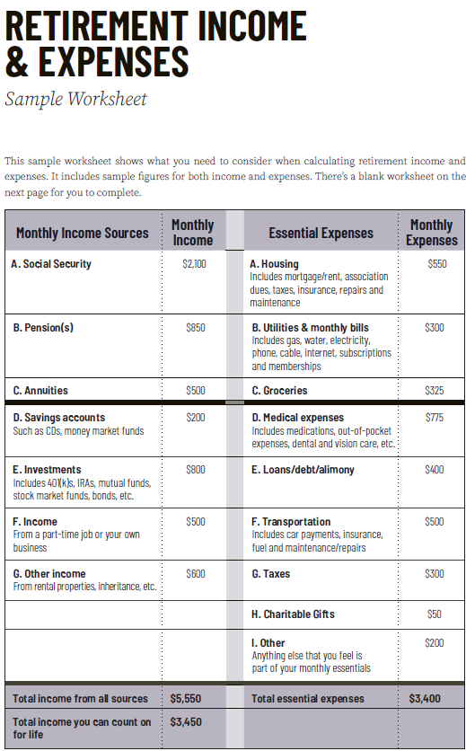
What we’ll discuss in our meeting
We’ll discuss your retirement readiness
We’ll talk about your goals for your life in retirement
We’ll talk about how to keep you on track
Notes:
Naturally, we’ll review your income hierarchy analysis at the meeting, especially if you have any questions about your process.
Plus:
We’ll discuss your retirement readiness to hear your thoughts about that.
We’ll also talk about your goals for your life in retirement. What will that mean for you in terms of living a full life?
And finally, we’ll talk about what how to keep you on track so you’ll feel confident and optimistic about your plans.
This usually takes less than an hour and, of course, these days, we can do it over Zoom or on the telephone.
You’ll have several opportunities to schedule your income planning discussion.
The first and easiest way is to simply type ”Yes” in the chat box right now. We’ll follow up to schedule the call.
We’ll also be sending a follow up email with links to a recording of this presentation. You can respond to that, too, and we’ll happily arrange a meeting.
So before we wrap up, I just want to say I hope you’ve found this presentation useful.
And I look forward to having an income planning discussion with you soon.
And, again, just go ahead and type YES in the chat box now to take your first step to scheduling your Income Planning discussion.
Finally, I just want to say thank you for following along. I appreciate you lending your attention to such an important topic.
Now, if anyone has questions, I’m happy to take them.
THEN TAKE QUESTIONS IF YOU LIKE.

Slide 49
Evaluation form
Notes:
HIDE THIS SLIDE IF YOU’RE DOING A WEBINAR. EVALUATION/APPOINTMENT SETTING FIRM IS ONLY FOR IN REAL LIFE PRESENTATIONS.
So take a minute to fill that out now.
We’ll follow up with you to find an alternate time if those listed don’t fit you schedule.

Slide 50
Questions?
Notes:
As we gather up the evaluation and appointment forms, are there any questions?

Slide 51
Disclaimers
Annuities are long-term investments designed for retirement purposes. The value of variable annuities is subject to market risk and will fluctuate. Product guarantees are subject to the claims-paying ability of the issuing insurance company.
Partial withdrawals reduce the cash value and certain benefits, such as the death benefit amount. Early withdrawals may be subject to withdrawal charges.
Earnings, when withdrawn, are subject to federal and/or state income tax, including a 10% tax penalty for withdrawals before age 59½.
Some income guarantees offered with annuities take the form of optional riders and carry charges in addition to the fees and charges associated with annuity products.
There is no guarantee that any investment will achieve its objectives, generate positive returns, or avoid losses. Investments in annuity contracts may not be suitable for all investors.
Northern Lights Distributors, LLC, a FINRA/SIPC member, has been retained to facilitate FINRA review of the material in order to meet certain requirements of its business partners. Northern lights Distributors, LLC is not affiliated with The Alliance for Lifetime Income.

